Slide 1
Voorbereidingen
1. Install:
R: https://cran.r-project.org/bin/windows/base/
Rstudio: https://www.rstudio.com/products/rstudio/download/
2. Save the epgrun_0.33 script and the “Run it” script to your computer (same folder)
3. Save the ANA files of plantline1 (or treatment1) in a folder with that name. So if you want to compare 2 treatments or 2 plant lines you need to have 2 folders with the ANA files of each
4. Open Rstudio
5. Install the package sciplot:
- Tools > Install Packages
- Search for sciplot
- Click “Install”
6. Open the Run it script (File> Open File)
7. Adapt the Run it script according to the instructions on the next page

Slide 2
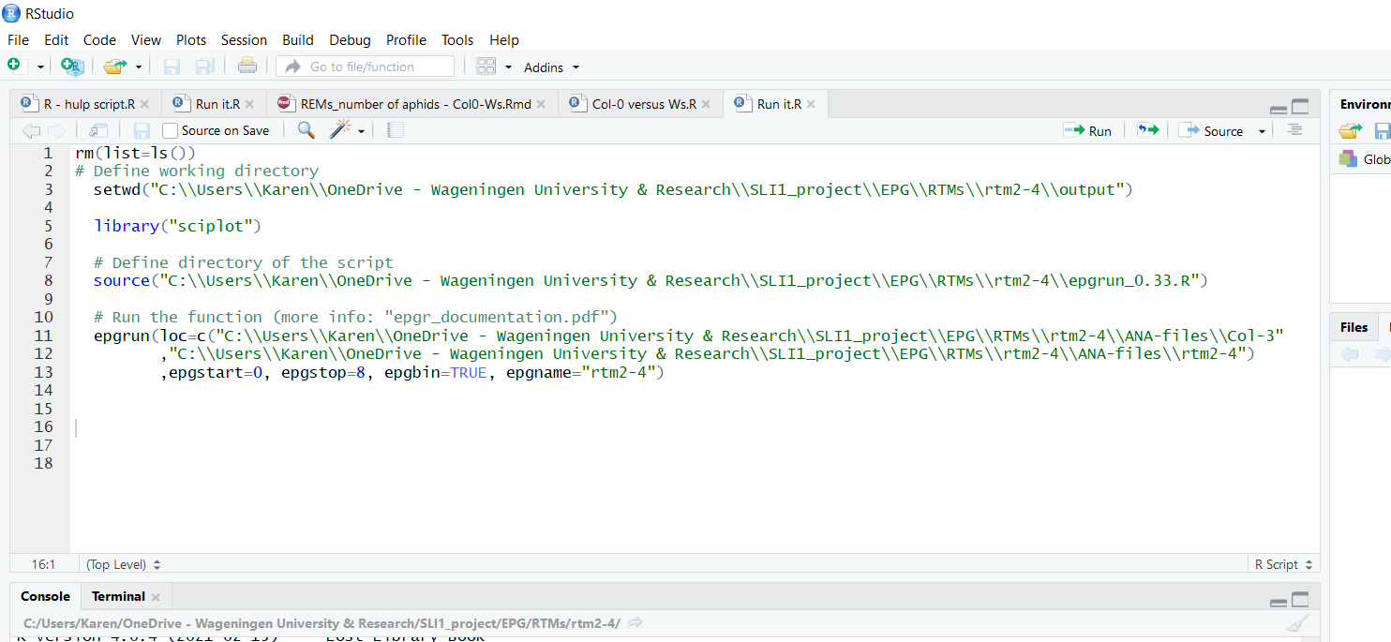
Location of the folder where you want to save the R*
Should contain: name of the epgrun script + location in folder,
It has to end with ”.R” extension!
Geef een naam voor het experiment
Location of your ANA files plantline1/treatment 1**
Location of your ANA files plantline2 /treatment 2**
* Use either ”\\” or ”/” between folder names. Easy is to copy-paste the locations from Windows Explorer search window
** ANA files need to have the extension ”.ANA” (in capital letters!)

